Slide 1

HTML Form Validations Presentation

Slide 2
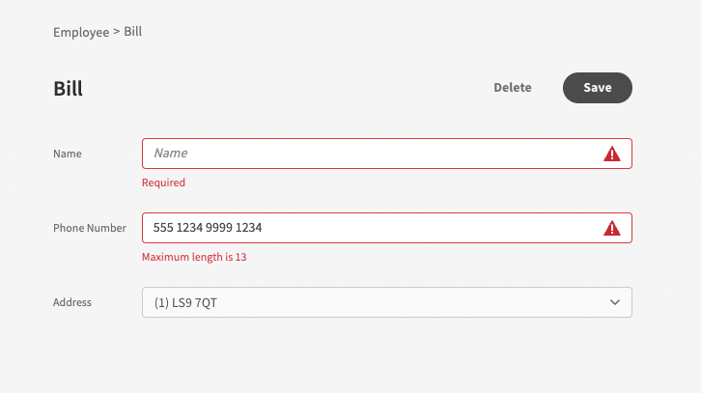
What is Html Form Validations:
Form validation in HTML is the process of checking data entered into a form to ensure it meets specific rules before it's submitted

Slide 3
Type Of Html Validations:
Required Field Validation
Format Validation
Length and Size Validation
Numeric and Data Type Validation
Pattern Matching Validation

Slide 4
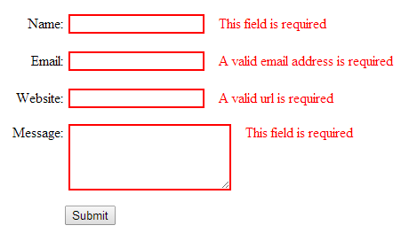
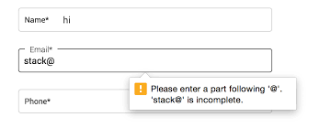
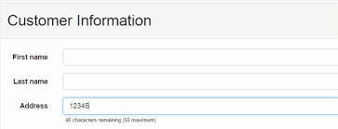
1.Required Field Validation:
It ensures that certain fields in a form must be filled out before submission.
2.Format Validation:
Checks whether the entered data follows a specific format (e.g., email addresses, phone numbers, dates).
3. Length and Size Validation:
Verifies that the length or size of the input falls within specified limits.

Slide 5
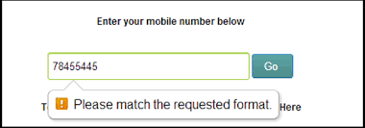
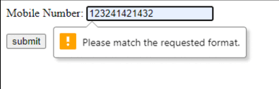
4. Numeric and Data Type Validation:
Ensures that the entered data is of the expected data type (numeric, alphabetic, alphanumeric).
5. Pattern Matching Validation:
Matches the input against a defined pattern, typically using regular expressions for complex patterns.

Slide 6
Advantages Disadvantages
Improved User Experience
Ease of Implementation
Faster Feedback
Reduction in Server Load
Consistency and Standardization
Limited Security
Browser Compatibility Issues
Limited Validation Capabilities
Dependency on User's Browser Settings
Inadequate for Comprehensive Validation

Slide 7
Conclusion
In conclusion, HTML form validation is a powerful tool that enables developers to create more robust and user-friendly web forms. By leveraging HTML attributes and elements, developers can enforce validation rules, improve data accuracy, and enhance the overall usability of web applications. However, combining client-side validation with server-side validation is crucial for comprehensive data validation and security.

Slide 8
Thank You
Any Queries:
mylapaliiappalaraju0703@gmail.com
9398026989

